Slide 1
Software Development Life Cycle (SDLC)
Presented by
A. Krishna Jothi

Slide 2
INTRODUCTION
SDLC is a step-by-step process used by software industry to design, develop, and test the software.
SDLC helps ensure that the development process is efficient, organized, and meets both the technical and user requirements.
The main goal of SDLC is to reduce errors and delays while delivering a product that meets customer expectations.

Slide 3
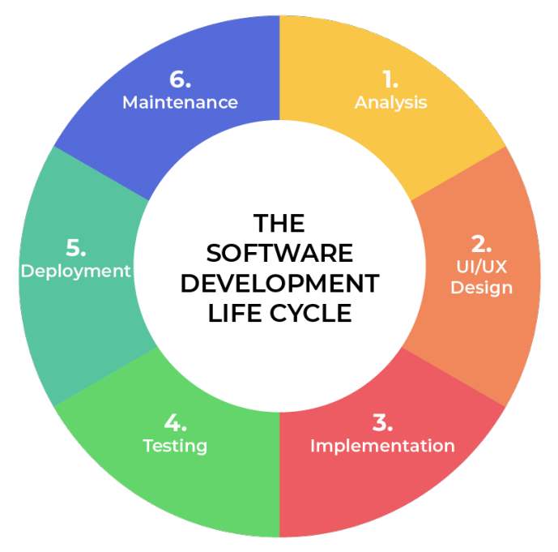

Slide 4
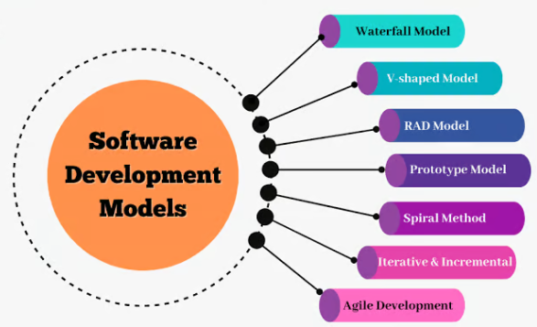
SDLC Models
Various SDLC Models
Waterfall Model
V-Model
Spiral Model
Prototype Model
Hybrid Model
Incremental Model
Iterative Model
Agile Model

Slide 5
Spiral Model
Spiral Model is a risk-driven software development process model.
The Spiral Model is a hybrid of the traditional Waterfall model and the iterative approach.
Software is developed in a series of incremental releases as per each spiral.
Example: Microsoft, OS Versions, Gaming industry etc.

Slide 6
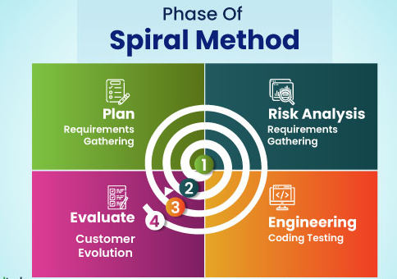
Spiral model divided into four parts:
Planning
Risk Analysis
Engineering and Execution
Customer Evaluation

Slide 7
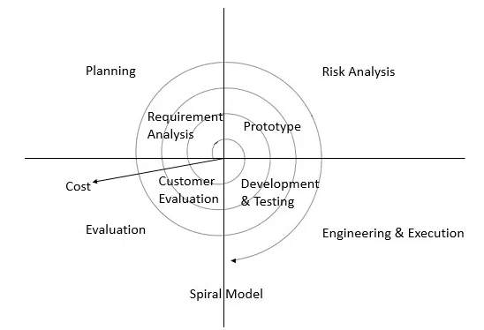
Architecture diagram of Spiral Model
Fig. Architecture diagram of Spiral Model

Slide 8
Planning: (Requirement Gathering and Analysis)
Communication between customers and project head.
Collect all the requirements from customers.
Analyses estimated cost, schedule and required resources.
Risk Analysis
Identification of all potential risks.
Risk mitigation strategy is planned for solving risks.
Design a prototype of model.

Slide 9
Engineering and Execution
Actual development start.
Designer design the product as per final prototype.
Developer perform actual coding or implementation.
Tester perform all testing methods.
Deploy or Release product to the customer environment.

Slide 10
Evaluation
After execution, moves to the customer evaluation part.
Here, take a feedback from customers.
If customer want any changes, goes to next planning or next spiral iteration.

Slide 11
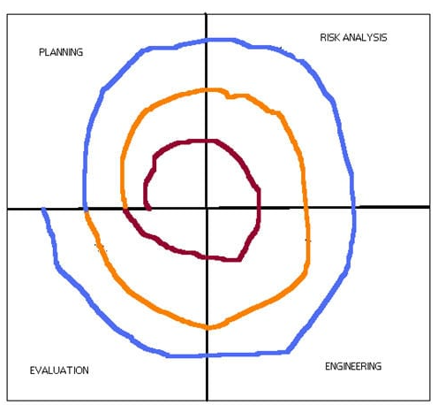
Benefits of Spiral Model
Risk Management.
Flexibility.
Customer Feedback.
Improved Quality.

Slide 12
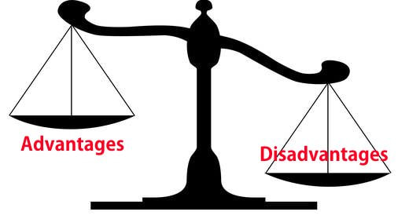
Challenges of Spiral Model
Complexity.
Costly.
Doesn’t work well for smaller projects.
Requires expertise.

Slide 13
Conclusion
To sum up, the Software Development Life Cycle (SDLC) helps create software in a structured way, step by step.
The Spiral Model is especially useful for big, complex projects because it allows to manage risks and improve the product with each cycle.

Slide 14
THANK YOU

